Slide 1
PODCASTING IN THE CLASSROOM
DIANA GALARRETA-AIMA
James Madison University

Slide 2
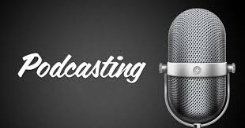
WHAT IS A PODCAST?
The name "podcast" originates from the combination of “iPod” and “broadcast.” There are many types of podcasts (educational, historical, scientific, etc.) but they are all made up of these basic elements: an audio file that is shared to a target or general audience via websites, online subscriptions, newsletters, music platforms, etc.

Slide 3
Important things to keep in mind
These are some things to consider before hitting the record button.
- What’s the podcast about? What kind of podcast is it?
-Who is the audience? ie: age groups, social groups, cultural & communities, local vs global, etc.
- Is there a direction? Whether it be an interview, a conversation or a scripted message, every successful story has a conclusion.
- What's the stance? podcast creators must define themselves and their position on the subject: narrator, avocate, interviewer, commentator, expert?

Slide 4
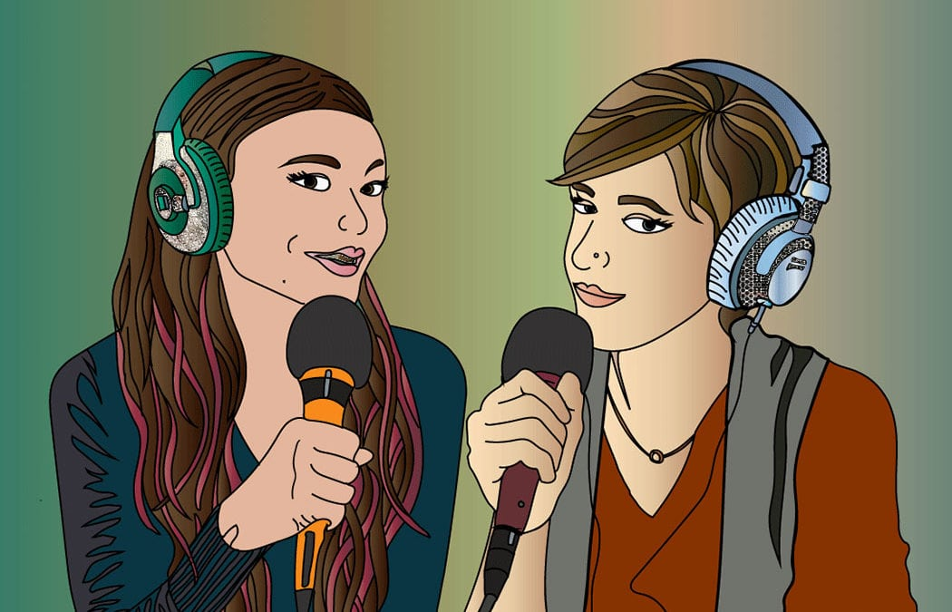
PODCAST IN HIGHER EDUCATION
While there is robust research on how to teach with podcasts, there is a significant gap in researching the learning benefits of students-produced podcasts.
Student-generated podcasts can be a great alternative to the traditional research paper and provide students with opportunities to learn more and engage with their local communities.
Moreover, podcasts offer an engaging way for instructors to merge project-based learning with digital media analysis and production skills.

Slide 5
BENEFITS ON INCLUDING PODCASTING IN THE CLASSROOM
Producing a podcast fosters a number of critical skills like researching and analyzing a topic, creating an outline, drafting a script, and interviewing and technological abilities, etc.
Educators foster a student-centered approach and enhance students’ motivation.
Podcasting can also cultivate collaborative work by developing the skills needed to work towards the same goal.
Podcasts enhance the digital literary skills students need in our modern Web-based society.
Notes:
When producing their own podcasts, students can select a topic they are passionate about or learn about a problem that affects their communities.
The fact students are actively engaged and are responsible for the production of a permanent and shareable material can increase motivation and make students feel in control of their own learning.

Slide 6
HOW TO MAKE THIS ASSIGNMENT SUCCESSFUL?
Challenge 1: Time-consuming. Provide time in class to work on the project.
Challenge 2: Anxiety-provoking. Give students different roles.
Challenge 3: Team-work problems. Ask students to share their progress in a Google Doc. Provide guidelines about team-work. Explain why it is important to learn to work with others.
Challenge 4: Technology issues. Partner with the library and offer constant support. Try it yourselves.

Slide 7
Anchor, let’s practice
In groups, go to Anchor. fm (watch video first) and create an account.
Tap any tool to add some audio to your episode answering the question: How would you include Podcasting in your classroom?
Add a caption and publish the segment to your podcast.
Keep adding segments to finish your episode. When you’re done, just give it a name and share it with the world! (or just us in this case)
Notes:
With Anchor, all you need to do is select the button that says “Distribute my podcast everywhere.” We’ll automatically submit your podcast to Apple Podcasts, Google Play Music, Overcast, and Pocket Casts. That’s it! We’ll notify you as it becomes available in each of these places; this process usually takes between 24-48 hours.
The best way to get your footing is to just start recording, listen to what you’ve made, and iterate from there. Anchor removes all the technical complications, so the only hurdle will be just figuring out what you want to say!

