Slide 1
Student Learning Communities: Using Live Videocalls & Texting to Create Engagement in Online Courses
Presented by: Dr. Amber Dailey-Hebert & Dr. Linda Passamaneck
Notes:
Hello and Welcome: I’m Amber and I’m Linda and we are here to share our research and experiences pertaining to one of the most significant challenges facing online instructors = which is how to create connected/engaged student learning communities online (where they feel connected to their instructor and peers in meaningful way).
Linda – I have been using online discussions, sort of the “gold standard” in online courses since 1997…
Amber – I have been using online videocalls since ----
Linda – I integrated Slack in my first course in 2015
Over the past decade we’ve been studying how our students respond to the integration of videoconferencing, text-based communication, and static content in our online courses.

Slide 2
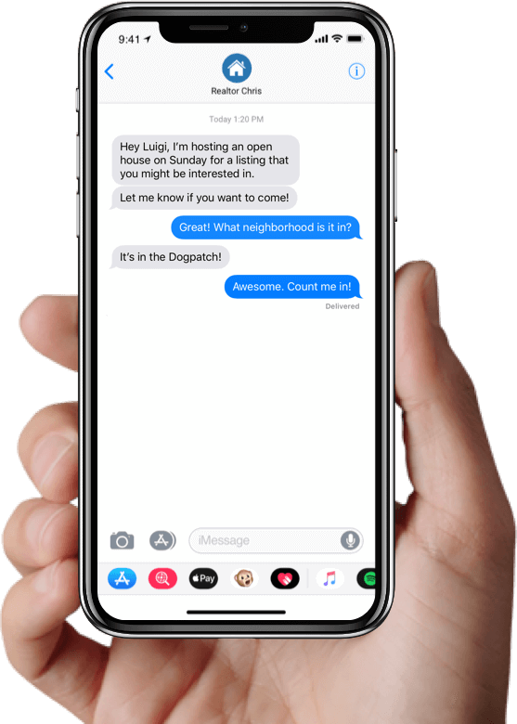
Can you think of a time when a videocall helped YOU connect with someone?
How many texts do you send/receive in a day?
Notes:
Introduction:
When/how has a videocall helped YOU connect with someone?
And how many texts would you estimate you send and receive in a day? (in 2019, for most folks, it’s about 94 a day)….worldwide, it’s about 23 billion a day (so basically a million texts were sent while you read this question). – (Dobrilova, 2019)
It’s clear to see that technology advances have enabled us to better connect and communicate, but can they also be used to help us improve learning? And our answer and research findings, quite simply, is yes (when used appropriately and intentionally).

Slide 3
Goals & Agenda
Overview/Examples of Tools
Results & Student Feedback about Videocalls and Texting
Implications for Designing and Teaching Online Courses
Notes:
Analyze and utilize tangible strategies to integrate video and texting
Explore free, open source tools to support video-based, text-based communication
Exchange experiences/ideas of successful implementation

Slide 4
Free or Open Source Tools We Use
Zoom
Free license = 40 min. calls Local Files
Slack
Free Workspaces
Limited Archiving
Slack Apps
Google Documents
Office 365
Zoom
Emoji
Notes:
It’s also important to note that we began with integration into one course, then made changes to integrate it into all courses in the program based on student demand. Which then led the university (5 years later) to adopt a university-wide license for zoom for every instructor.
Student habits are also what led us to notice that students were working around our LMS to communicate (texting each other and we didn’t know what was/wasn’t going on outside of class in those communications – so we integrated slack.

Slide 5
Strategies We Use - Videocalls
Live sync session (discussion, presentation, mini-lecture)
Invited guest presenters, Q&A (PBL)
Team projects (self-organized team meetings)
Practice and/or record presentations
Solving a problem together real-time
Software demonstration
Role-playing
Debate
Polling
Break out rooms

Slide 6
Student Feedback - Videocalls
“Before we started the course I wasn't keen on having to be present for online discussions. Now, I can really appreciate how helpful it is to collaborate with my classmates and professor.”
“This platform has been the best tool I have used in my Graduate schooling. I like how we can come together and be able to talk face to face. It helps to be able to ask question and get feedback right away.”
“I think the video calls make the course so much better because we can discuss assignments/questions/concerns… it was great to see everyone's face. I honestly was upset I missed the last video call due to traveling, I even tried to connect from the plane…”
Notes:
We collect feedback from students every term through formal surveys, as well as through focus groups…these are some comments from students about the use of videocalls…

Slide 7
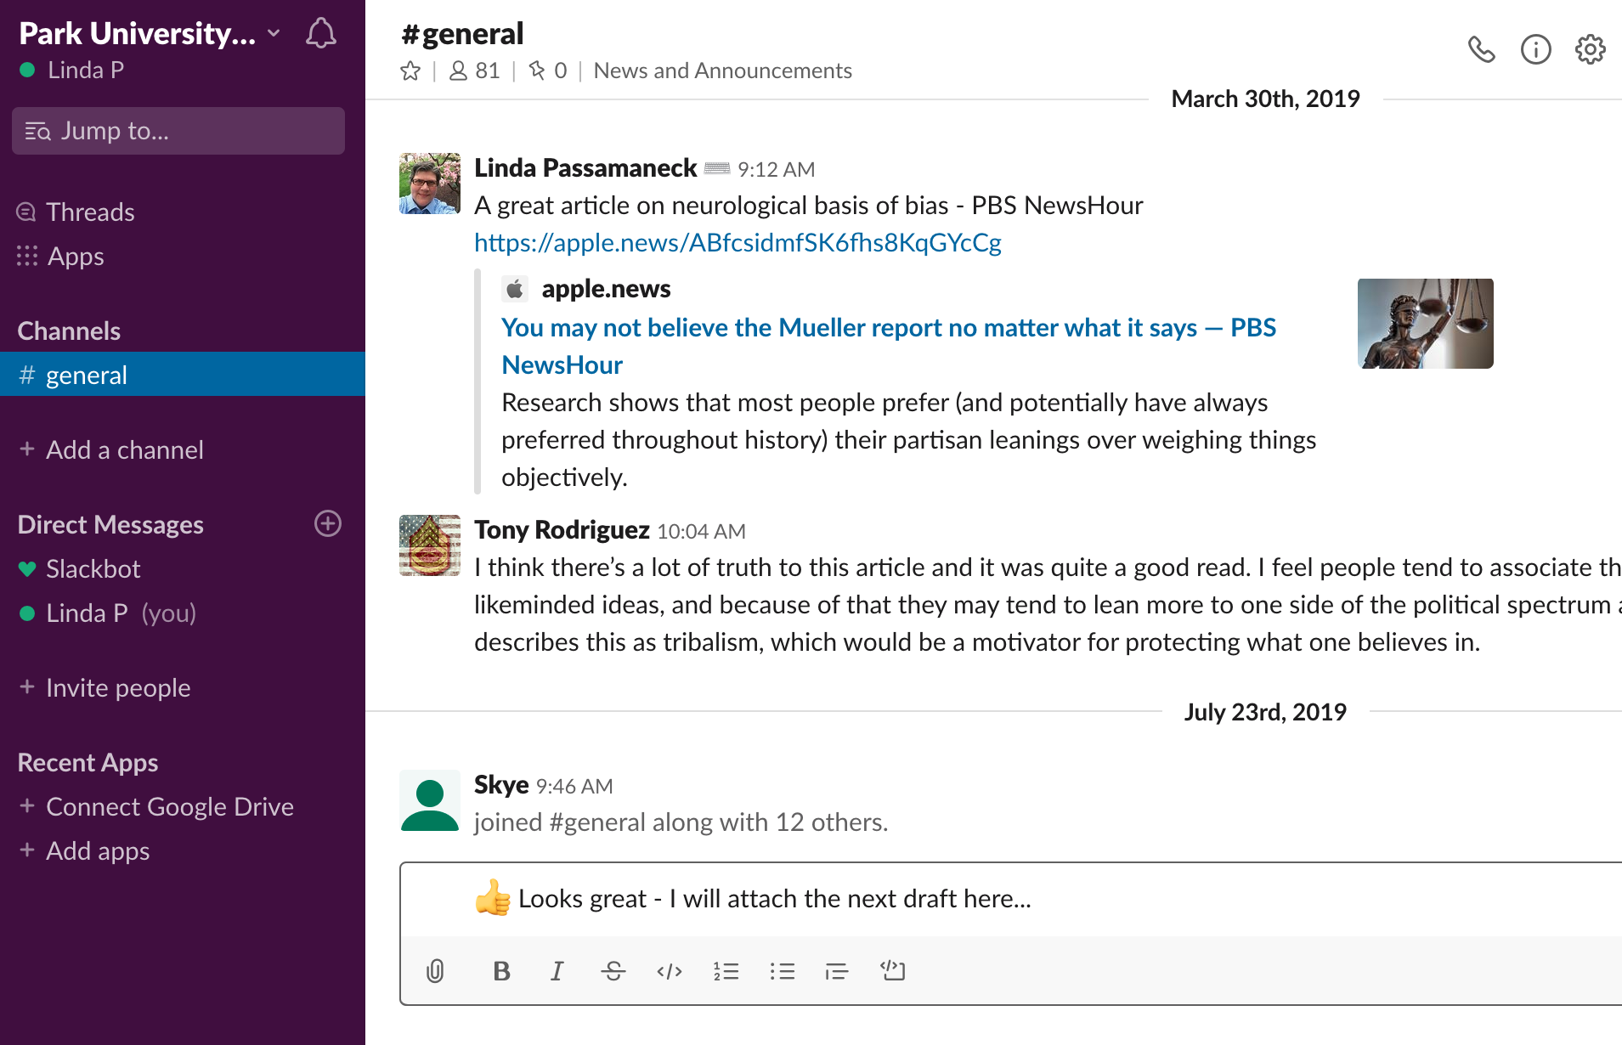
Strategies We Use - Slack
Internal Group Work/Team projects
Course Announcements
Office Hours/Office Areas (Q&A)
Resource Sharing (Document/video/ Links)
Collaborative Knowledge Sharing (peer learning)
Polling

Slide 8
Student Feedback - Slack
“I never realized how important having slack would be until we were messaging and sharing so much information on slack.”
“It provided a great method for our team to facilitate daily communication and interactions. the capability to share documents was a great feature within slack. Our team was able to share the items that we worked on which ensured we WERE constantly working together."
“Slack is the most effective thing. I got messages in real time like texting and I was able to upload my team video.
The capabilities are amazing and I have implemented this with work team members so no one had to give up their personal data.”

Slide 9
Communication Tool: | Discussions | Videocalls | Text-based Messaging
Real-Time Capability |  | 👍🏻 | 👍🏻
Formal Written Responses | 👍🏻
Groups | 👍🏻 | 👍🏻 | 👍🏻
Multi-device compatible |  | 👍🏻 | 👍🏻
3rd Party Apps | 👍🏻 (Few) |  | 👍🏻 (Many)
Document Collaboration |  |  | 👍🏻
Private Messages/Ad Hoc |  | 👍🏻 | 👍🏻
Archived | 👍🏻 | 👍🏻 | 👍🏻
Gradebook Integration | 👍🏻 | 👍🏻

Slide 10
Research Questions:
Do videocalls and slack build greater learning community in online courses?
Which tool/method do students prefer when engaging with:
Content
Instructor
Classmates
Should we expand the use of Slack into all program courses?
Notes:
Sabbatical work led us to investigate the impact of weekly videoconferencing to supplement and support work within their course team projects. And we investigated:
Activation of prior knowledges
Communication climate
Group learning
Satisfaction
And also led us to investigate the use or text-based communication (as well as a comparison among static course content, video-based communication and text-based communication).
Given the limited time here today, we will share the more broad overview of our findings, but they revealed (read slide).

Slide 11
Research Results: Videocalls (Our Findings)
Synchronous videocalls helped to:
promote deeper connection, team exchange, & activation of prior knowledge.
establish a positive communication climate that leads to a greater level of collaborative knowledge sharing and group learning
improve overall satisfaction in the course
Notes:
Sabbatical work led us to investigate the impact of weekly videoconferencing to supplement and support work within their course team projects. And we investigated:
Activation of prior knowledges
Communication climate
Group learning
Satisfaction
And also led us to investigate the use or text-based communication (as well as a comparison among static course content, video-based communication and text-based communication).
Given the limited time here today, we will share the more broad overview of our findings, but they revealed (read slide).

Slide 12
Research Results: Text-Based Messaging (Our Findings)
Students perceived text-based communication (Slack) allowed for:
improved overall communication and team learning in their groups
more immediate feedback and responsiveness to their questions
more connection to their classmates & to their instructor
streamlined work and save timing for their teams
a knowledge-sharing culture to be promoted (building psychological safety and trust in their teams).
Notes:
90% for all
100% for last bullet
We used the classroom community scale, edmondson’s survey questions on psychological safety and communication climate, along with group learning satisfaction survey questions.

Slide 13
Research Results: Engaging w/ Content
Student Preferences Related to Engaging w/ Content:
Learning a new theory: 50% Live videocalls / 50% course materials Researching a new topic: 60% Course materials / 30% discussion boards
Completing individual assignment or activity: 60% course materials / 20% discussion boards / 20% Videocalls
Notes:
Most recently this past year

Slide 14
Research Results: Engaging w/ Instructor
Student Preferences Related to Engaging w/ Instructor:
Asking my instructor questions 60% Videocalls / 40% Slack
Sharing information with my instructor 50% slack / 40% videocalls / 10% discussion board
Receiving feedback/rapid response from my instructor 40% videocalls / 30% slack / 20% discussion board
Notes:
Most recently this past year

Slide 15
Research Results: Engaging w/ Classmates or Team
Student Preferences Related to Engaging w/ Classmates/Team:
Forming a new team: 60% slack/ 20% videocalls/ 20% discussion
Brainstorming with my team: 50% slack/ 30% videocall/ 20% discussion boards
Asking questions of my classmates/teammates: 50% slack/ 30% discussion boards/ 20% videocall
Seeking clarification about the course activities or assignments: 50% slack/ 20% videocalls/ 20% discussion boards
Sharing information and resources with my classmates/teammates 80% slack/ 20% discussion boards
Notes:
Most recently this past year

Slide 16
Research Results: Communication Tool Comparison & Analysis
Students ranked text-based messaging as the most preferred collaborative tool overall
…but just barely:
Text-based messaging - 35%
Videocalls – 34%
Discussion boards – 30%
Comparing slack to asynchronous discussion boards:
70% reported that slack builds greater sense of connection
60% reported that slack is easier to use
Comparing slack to synchronous videocalls:
50% both equally contribute to learning overall (40% preferred videocalls)
50% videocalls builds a great sense of connection to your classmates (30% rated the tools equally)
40% slack makes it easier to share resources and information with your classmates (30% rated the tools equally)
40% videocalls build great sense of connection to your instructor (40% rated the tools equally)
70% of students want to expand use of text-based messaging into all program courses
Notes:
Most recently this past year

Slide 17
Implications
Our criteria for tool selection:
- Must be instructor/institution controlled
- Must allow for archiving
- Must be free for students
- Must be easy to use
- Integration with LMS and other communication tools a bonus

Slide 18
Implications
Discussions may be losing status as the “Gold Standard” for online communication and collaboration
As with all good instructional design – start with the end in mind – select the best tool based on your instructional goal
Most courses will benefit from a mixed-use strategy of these tools

Slide 19
Questions, Thoughts, Ideas?
adailey@park.edu & linda.passamaneck@park.edu

