Slide 1
Transforming the Village, Partnering for Student Success
Amy Simons, MSN, RN

Slide 2
Expected Outcomes
Describe the importance of student engagement for persistence and program completion.
Introduction to an innovative project designed to transform college and community partnerships.
Describe ways to incorporate similar projects to improve student success in alignment with accreditation standards.

Slide 3


Slide 4

My definition of kindness:
It is marked by ethical characteristics, a pleasant disposition, and concern for others. It implies that other people matter; it is both energetic and interactive and is implicit in interpersonal relationships.

Slide 5
Importance of Partnering
Partnering builds community, establish relationships, helps students engage with one another and faculty.
Demonstrates to students that they matter.
Kindness is the framework used in the partnering to enhance student engagement and success, develop intra-professional collaboration, and bridge the gap between educational and professional implementation

Slide 6

Three Pillar Approach

Slide 7

Orientation

Slide 8
Classroom Culture

Slide 9
Faculty Modeling

Slide 10
Effects on the Brain
Emotion is connected to cognition
Stress impacts the size and ability of the brain
Prosocial activities create safe feelings needed for learning

Slide 11

Kindness improves concentration, alleviates stress, and encourages collaboration.

Slide 12
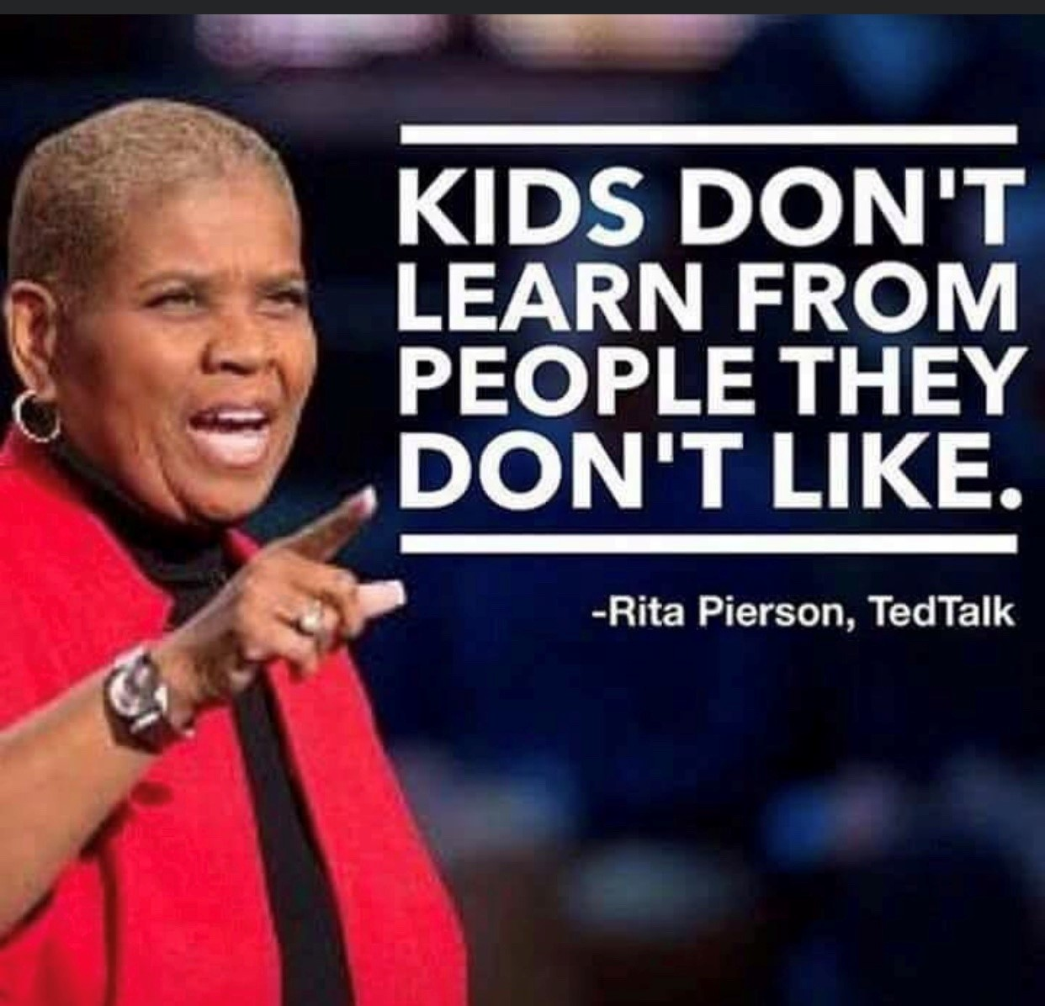
Discuss:
How can you implement some of these ideas for your students?

