Slide 1
Using Student-Created Poetry to Build Community
Laura Slay, Jacqueline Riley & Carol Revelle
Texas A&M University - Commerce
Lilly Conference - January 2020
Austin, TX
Notes:
1 minute
Introduce ourselves and mention that we work in teacher education in a large rural university that serves predominantly first generation college students. Our student population
Laura slides 1-6

Slide 2
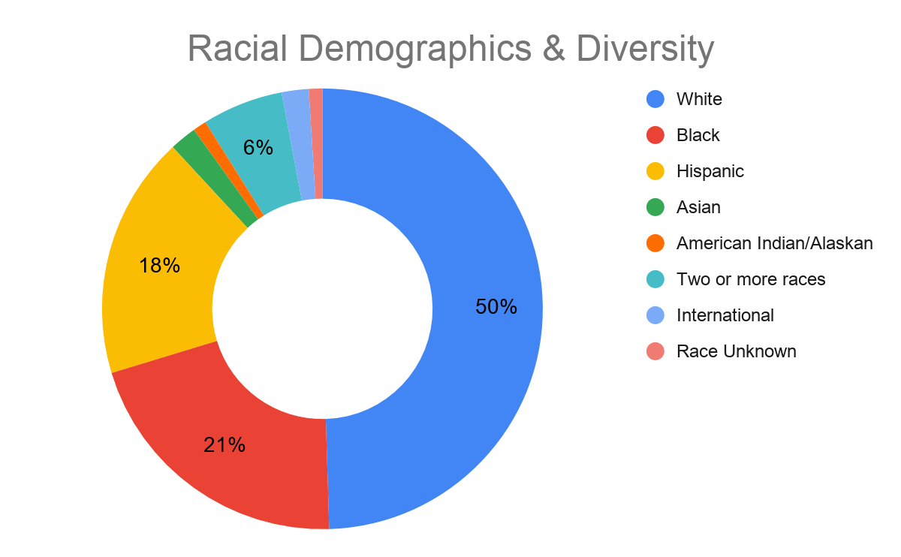
Our Demographics
Undergraduate enrollment: 12, 411
Students over 25 years old: 33.6%
Part-time undergrads: 26.8%
Median household income: $57, 562/year
Notes:
1 minute
Source: https://www.collegesimply.com/colleges/texas/texas-a-and-m-university-commerce/students/
For context - Introduce ourselves and mention that we work in teacher education in a large rural university that serves a predominantly white student population (50%), yet is inclusive of students of different backgrounds, (50% minority population). A large number of our students are considered to be first generation college students.
“A college's ethnic diversity is indicated by the student body's equal inclusion of students from different backgrounds . Students at A&M Commerce are predominantly White with a sizeable Black population. The school has very high racial diversity. 50% percent of students are minorities”. (https://www.collegesimply.com/colleges/texas/texas-a-and-m-university-commerce/students/)

Slide 3
Student Engagement
What factors affect student engagement in your classes?
Notes:
5 minutes
Open with a question - answers should lead to the need for classroom community - and recognizing the silent ones. Are there some students who look lost and disinterested? Or are there others who sit passively and never speak up; leaving the vocal ones to respond and speak for the class. Once, when I asked a group of Latina students why they never talked in class, I was told that no one wanted to hear what they have to say. Have you ever wondered about the silent voices in the room? How can you draw them into the class discussion. Although a lack of engagement may look like apathy at times; maybe engagement is tied really tied to a sense of agency or self-confidence.
Whole group or think/pair/share - depending on group interaction and time.

Slide 4
The social and emotional skills that are most relevant to higher education students are those that can promote their personal and interpersonal awareness and competence, and therefore help them navigate new and challenging academic, social, and emotional terrain.
Conley, 2015, p. 198
Notes:
1 minute
Some might tie self-confidence and agency to a sense of interpersonal awareness and competence. Colleen Conley claims that students students’ success in college is related to their social and emotional skills, which may be too often overlooked. Consequently, personal and interpersonal awareness and competence lead to developing a keen sense of agency, and hopefully academic and social engagement.

Slide 5
Theoretical Framework
Core SEL Competencies to Higher Education Populations: What students need to learn.
Self-awareness
Self-management
Social awareness
Relationship skills
Responsible decision making
Collaborative for Academic, Social, and Emotional Learning (CASEL), 2012
Culturally Responsive Teaching: What instructors need to do.
Develop knowledge of cultural diversity
Design culturally relevant curricula
Demonstrate cultural caring and build a learning community
Maintain cross-cultural communications
Establish cultural congruity in classroom instruction
Preparing for Culturally Responsive Teaching, (Gay, 2002)
Notes:
1 minute
The activity we will share with you today stems from two theories including social and emotional learning and culturally responsive teaching. Our work specifically touches on the highlighted bullets. We invite you to participate in a brief writing activity that we have found helps to establish a sense of community in the classroom by building students’ sense of self-awareness, social awareness, and relationship skills by developing knowledge of cultural diversity, demonstrating cultural caring and build a learning community, and initiate steps toward maintaining cross-cultural communications.

Slide 6
Writing Can Build Agency
Instructors write and learn with students.
Students express themselves and their identities.
Community emerges from the shared writing experiences.
“Agency says to the adult learner, what you do matters; what you do has an impact on someone or something”.
Jones, 2011, p. 226
Notes:
1 minute
As educators we know that the hard work of writing moves us to grapple with ideas and make meaning with language. Because writing is thinking, it also represents a piece of ourselves. Today we will use a poetry template to prompt thinking about our personal identities as a guiding tool for building community in the classroom through a shared writing activity. To build trust, it is important for students to see their instructors work through the hard parts of writing with them. Sometimes writing makes us feel vulnerable and yet powerful at the same time. Working through this process together communicates a sense of empathy and agency while building community of learners across the unique identities this poem will reveal.

Slide 7
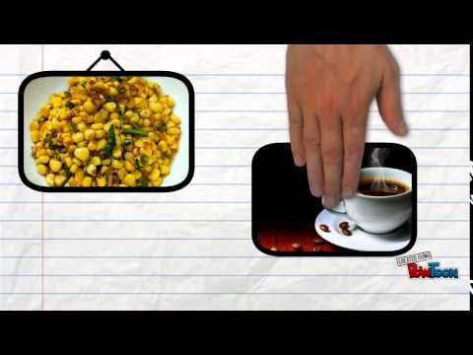
Where I’m From
by George Ella Lyon
where.html
http://www.georgeellalyon.com/
Notes:
3 minutes
An educator and writer from the Appalachian Mountains in Kentucky, George Ella Lyon, wrote the first Where I’m From poem.Using environmental artifacts and family memories, her poem exploring her identity has been replicated in national projects for social justice and schools across the country. You can learn more about George Ella Lyon and her work at her website: http://www.georgeellalyon.com/where.html
I first learned about this poem as a participant of the North Star of Texas Writing Project, which is part of the National Writing Project which focuses on teachers leading teachers to teach writing. Watch this video found online of Lyon’s poem using Powtoons. You can also find a model of the poem I wrote during that institute is in your handouts.
Jackie 7-13

Slide 8
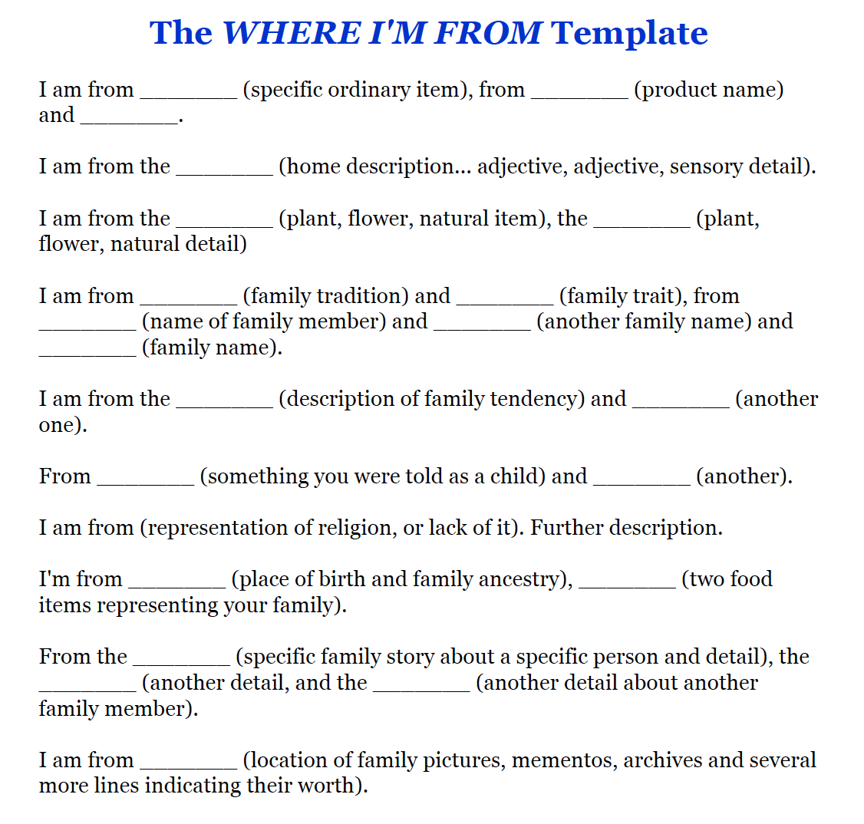
Where I’m From Poem Template
Brainstorm ideas with the template.
Encourage creative license to suite unique identities.
Modify the prompts to fit your content.
Promote discussion about identity and word choice.
It’s the process and sharing that matter.
Template modified from https://www.sausd.us/cms/lib/CA01000471/Centricity/Domain/3043/I%20Am%20From%20Poem.pdf
Notes:
2 minutes
So here is the template, which you will also find in your hand-outs. The pattern is simple. Each line begins with I am from and prompts you to consider artifacts to describe specific memories. In your hand out you will see this template and a more detailed template by asking for adjectives to prompt description in some places. (Read the template).
Templates for handouts: https://www.sausd.us/cms/lib/CA01000471/Centricity/Domain/3043/I%20Am%20From%20Poem.pdf

Slide 9
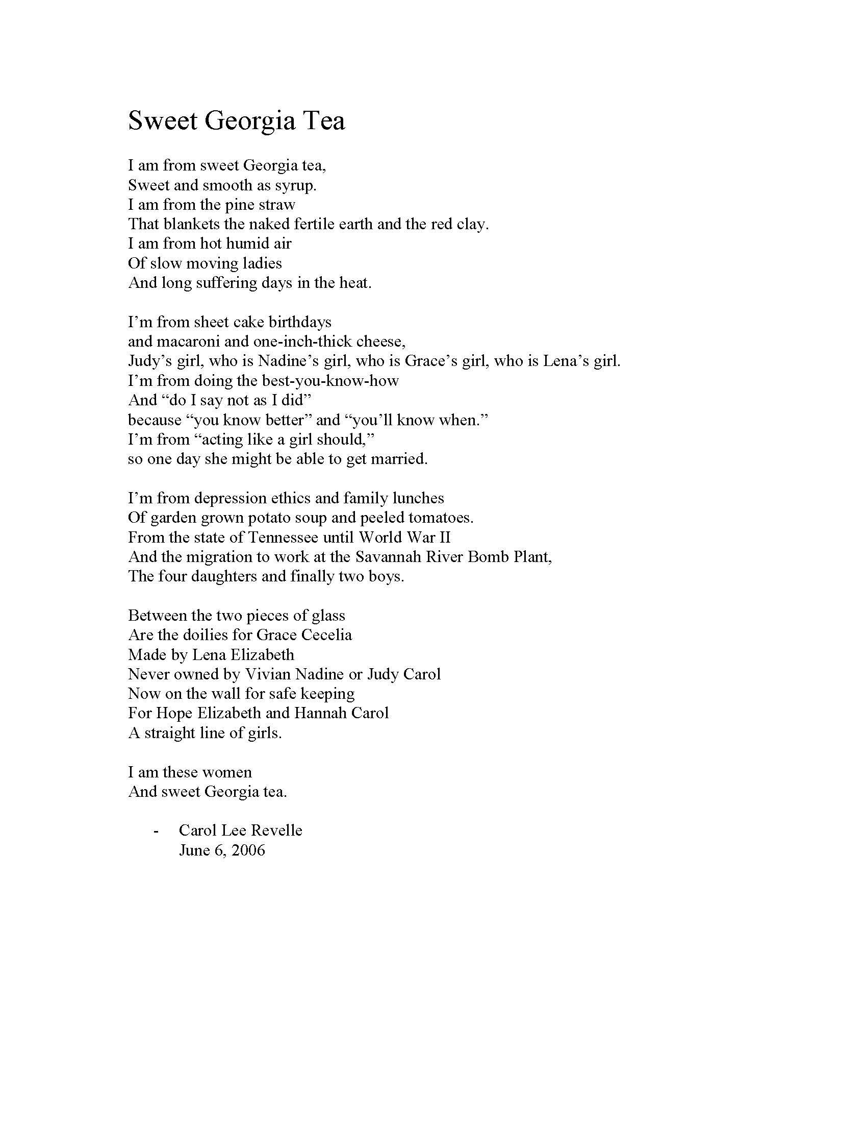
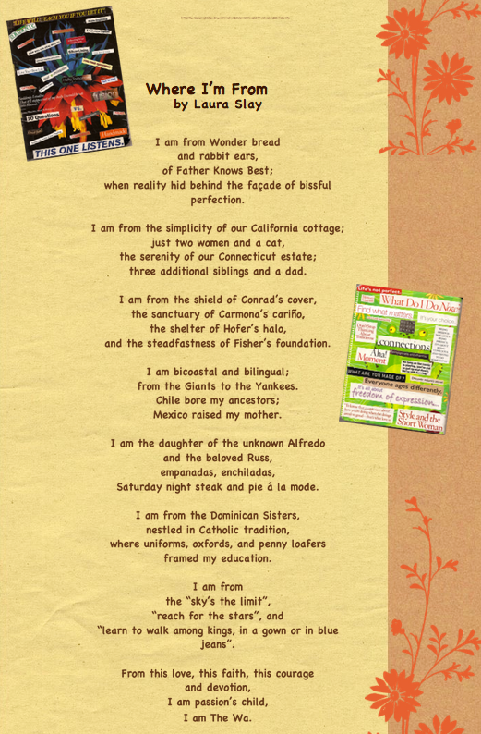
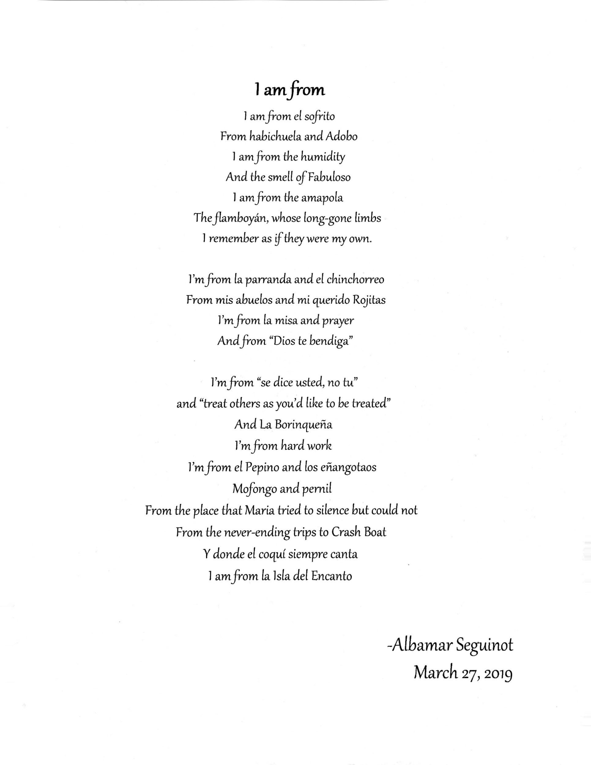
Notes:
3 minutes
Here you will see my version of the poem I wrote in 2008 which features elements of my bicultural heritage. (Read aloud). The poem on the left, Sweet George Tea, was written by Carol Revelle, also a consultant with the same writing project and our faculty colleague who could not be with here with us today. Her poem features her growing up in Georgia. You will notice that neither of our poems follow the same format as the original. Instead we used Lyon’s prompts in her template to shape our own poetic style. Many of us at Texas A&M Commerce have used this poem in our education classes at the beginning of the semester to establish rapport and break down barriers in the beginning of our courses. As teacher educators, we also hope to give our students a tool to use when they become teachers. The poem on the included the poem on the right is a bilingual poem written by one of my student teachers featuring her Puerto Rican heritage.

Slide 10
Sweet Georgia Tea
I’m from depression ethics and family lunches
Of garden grown potato soup and peeled tomatoes.
From the state of Tennessee until World War II
And the migration to work at the Savannah River Bomb Plant,
The four daughters and finally two boys.
Between the two pieces of glass
Are the doilies for Grace Cecelia
Made by Lena Elizabeth
Never owned by Vivian Nadine or Judy Carol
Now on the wall for safe keeping
For Hope Elizabeth and Hannah Carol
A straight line of girls.
I am these women
And sweet Georgia tea.
- Carol Lee Revelle
June 6, 2006
I am from sweet Georgia tea,
Sweet and smooth as syrup.
I am from the pine straw
That blankets the naked fertile earth and the red clay.
I am from hot humid air
Of slow moving ladies
And long suffering days in the heat.
I’m from sheet cake birthdays
and macaroni and one-inch-thick cheese,
Judy’s girl, who is Nadine’s girl, who is Grace’s girl, who is Lena’s girl.
I’m from doing the best-you-know-how
And “do I say not as I did”
because “you know better” and “you’ll know when.”
I’m from “acting like a girl should,”
so one day she might be able to get married.
I
Notes:
3 minutes
Here you will see my version of the poem I wrote in 2008 which features elements of my bicultural heritage. (Read aloud). The poem on the left, Sweet George Tea, was written by Carol Revelle, also a consultant with the same writing project and our faculty colleague who could not be with here with us today. Her poem features her growing up in Georgia. You will notice that neither of our poems follow the same format as the original. Instead we used Lyon’s prompts in her template to shape our own poetic style. Many of us at Texas A&M Commerce have used this poem in our education classes at the beginning of the semester to establish rapport and break down barriers in the beginning of our courses. As teacher educators, we also hope to give our students a tool to use when they become teachers. The poem on the included the poem on the right is a bilingual poem written by one of my student teachers featuring her Puerto Rican heritage.

Slide 11
Where I’m From
I am the daughter of the unknown Alfredo
and the beloved Russ,
empanadas, enchiladas,
Saturday night steak and pie á la mode.
I am from the Dominican Sisters,
nestled in Catholic tradition,
where uniforms, oxfords, and penny loafers
framed my education.
I am from
the “sky’s the limit”,
“reach for the stars”, and
“learn to walk among kings, in a gown or in blue jeans”.
From this love, this faith, this courage
and devotion,
I am passion’s child,
I am The Wa.
-- Laura Slay
June 2008
I am from Wonder bread
and rabbit ears,
of Father Knows Best;
when reality hid behind the façade of blissful perfection.
I am from the simplicity of our California cottage;
just two women and a cat,
the serenity of our Connecticut estate;
three additional siblings and a dad.
I am from the shield of Conrad’s cover,
the sanctuary of Carmona’s cariño,
the shelter of Hofer’s halo,
and the steadfastness of Fisher’s foundation.
I am bicoastal and bilingual;
from the Giants to the Yankees.
Chile bore my ancestors;
Mexico raised my mother.
Notes:
3 minutes
Here you will see my version of the poem I wrote in 2008 which features elements of my bicultural heritage. (Read aloud). The poem on the left, Sweet George Tea, was written by Carol Revelle, also a consultant with the same writing project and our faculty colleague who could not be with here with us today. Her poem features her growing up in Georgia. You will notice that neither of our poems follow the same format as the original. Instead we used Lyon’s prompts in her template to shape our own poetic style. Many of us at Texas A&M Commerce have used this poem in our education classes at the beginning of the semester to establish rapport and break down barriers in the beginning of our courses. As teacher educators, we also hope to give our students a tool to use when they become teachers. The poem on the included the poem on the right is a bilingual poem written by one of my student teachers featuring her Puerto Rican heritage.

Slide 12
I am from
I'm from "se dice usted, no tu"
and "treat others as you'd like to be treated"
And La Borinqueña
I'm from hard work
l'm from el Pepino and los enangotaos
Mofongo and pemil
From the place that Maria tried to silence but could not
From the never-ending trips to Crash Boat
Y donde el coquí siempre canta
I am from La lsla del Encanto
-Albamar Seguinot
March 27, 2019
I am from el sofrito
From hahichuela and Adobo
I am from the humidity
And the smell of Fabuloso
I am from the amapola
The flamboyán, whose long-gone limbs
I remember as if they were my own.
I'm from la parranda and el chinchorreo
From mis abuelos and mi querido Rojitas
I'm from la misa and prayer
And from "Dios te bendiga"
Notes:
3 minutes
Here you will see my version of the poem I wrote in 2008 which features elements of my bicultural heritage. (Read aloud). The poem on the left, Sweet George Tea, was written by Carol Revelle, also a consultant with the same writing project and our faculty colleague who could not be with here with us today. Her poem features her growing up in Georgia. You will notice that neither of our poems follow the same format as the original. Instead we used Lyon’s prompts in her template to shape our own poetic style. Many of us at Texas A&M Commerce have used this poem in our education classes at the beginning of the semester to establish rapport and break down barriers in the beginning of our courses. As teacher educators, we also hope to give our students a tool to use when they become teachers. The poem on the included the poem on the right is a bilingual poem written by one of my student teachers featuring her Puerto Rican heritage.

Slide 13
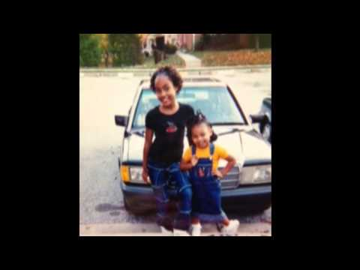
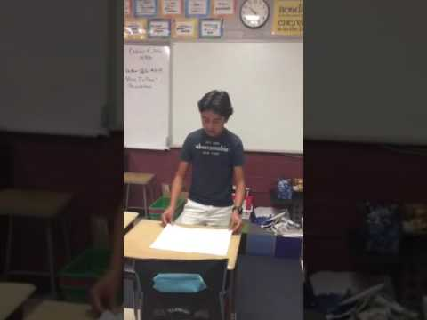
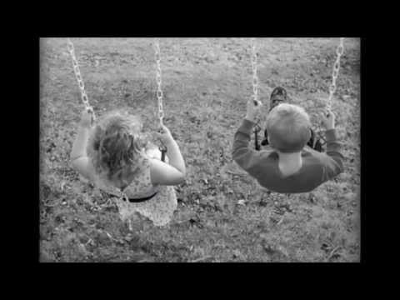
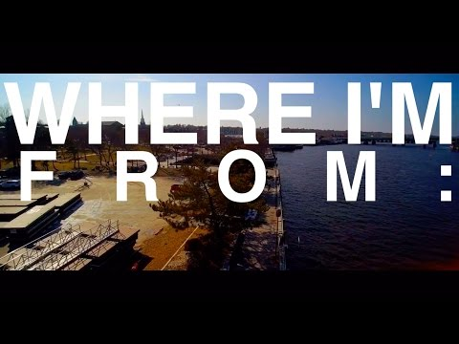
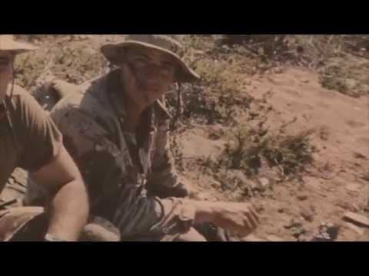
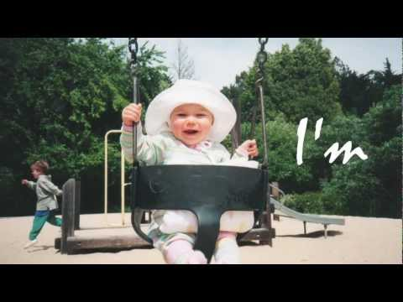
Digital Mentor Texts
Notes:
1 minute
Where I’m From has been used in many contexts, including elementary through university and professional development contexts. Many instructors have assigned a digital component to the assignment, although I do not require it in my education courses. Although we won’t have time to view all of these videos, feel free to explore the many versions of this powerful writing experience. An internet search will reveal many versions of this poem across grade levels; however, for purposes of this conference I selected videos featuring by adults writing about many topics, including their heritage, interests, hobbies, and families.

Slide 14
The Process is Easy
Write
Confer
Share
Sustained silent writing. Use the template to guide your thinking.
15 minutes
Share with a partner or writing group to hear your voice and get feedback.
5 minutes
Share aloud. Read poems aloud in circle or round table. Don’t forget this step. It is the essential to building community.
5 minutes
If short on time, have students complete their poem or digital project at home to present during the next class. Modify this time frame to suit your class.
Notes:
25 minutes
Write 15 minutes (to music); 5 minutes partner share; 5 minutes share aloud
So join us in the process. Use your template to write. Feel free to simply fill in the template, and then personalize to write your own poem. Use the parts of the template that fit your message. We will write for 15 minutes of sustained silent writing time. When the music stops, you will be asked to share with a partner near you to hear your voice and get feedback. And the last step - the most essential step for building community is in the sharing. In my classroom, my students shared in a large circle facing each other. Holding only a copy of their own poem. They self-select when to read aloud. We do not comment or clap. We simply share our poems aloud in a read-around. Depending on our context, we debrief the experience. I’ve learned to provide a box of kleenex, as reading aloud our work about ourselves is both humbling, intimidating for some, and very powerful.
Alternate 30 minute timer: https://youtu.be/vle8A0IK_Hw
Laura 14-17

Slide 15
Cross-Curricular Modifications
History/Literature
Write the poem from the perspective of an historical figure or a book character.
Science/Geography
Write the poem from the perspective of a scientist, a particular era, or scientific artifact.
Mathematics
Write the poem from the perspective of mathematical concepts.
More info on how to use this Where I’m From poem template can be found @ https://global.umn.edu/icc/documents/I_Am_From_Faculty_Guide.pdf and http://www.georgeellalyon.com/where.html
This poem can be modified to use in other contexts across content areas and grade levels. Use your own course content to set up the parameters. Then allow your students to be as concrete, creative, or imaginative as they wish.
Notes:
1 minute
Thank you for sharing. Because we know that we aren’t all English teachers, we thought it might be useful to explore ways this poem can be modified for use in other disciplines. History and literature teachers may ask students to write from the perspective of a literary character or an historical figure. Science teachers may hone in on writing about a scientist, personify an artifact, a scientific concept or era. In math, teachers may ask students to write about themselves as mathematicians, or from the perspective of mathematical concepts, such as fractions, zero, for example. Feel free to ask students to include ideas about the content areas you teach in your assignment.

Slide 16
Your Thoughts
How might you use this poem activity in your discipline?
Notes:
5 minutes
Open with a question - answers should lead to the need for classroom community - and recognizing the silent ones. Are there some students who look lost and disinterested? Or are there others who sit passively and never speak up; leaving the vocal ones to respond and speak for the class. Once, when I asked a group of Latina students why they never talked in class, I was told that no one wanted to hear what they have to say. Have you ever wondered about the silent voices in the room? How can you draw them into the class discussion. Although a lack of engagement may look like apathy at times; maybe engagement is tied really tied to a sense of agency or self-confidence.
Whole group or think/pair/share - depending on group interaction and time.

Slide 17
Community in the College Classroom
Comments and questions?
TAMUC Students Conferring (Photo by Laura E. Slay, 2019)
Notes:
5 minutes
Whether you use this writing opportunity for assessment or introductions, the experience will reveal information about your students and build a more engaged community of learners. What comments or questions do you have?

Slide 18
References
Conley, C.S. (2015). SEL in higher education. In Handbook of social and emotional learning: research and practice. (197-212). Retrieved from Loyola eCommons, Psychology: Faculty Publications and Other Works.
College Simply. (2020). https://www.collegesimply.com/colleges/texas/texas-a-and-m-university-commerce/students/
Dallalfar, A, Kingston-Mann, & Sieber, R.T (2011). Transforming culture: inclusive pedagogical practices. New York, NY: Palgrave MacMillan.
Day, Johanna (n.d.) https://www.youtube.com/watch?time_continue=6&v=T-9KwCTJRyI&feature=emb_logo
Gay, G. (2002). Preparing for culturally responsive teaching. Journal of Teacher Education, 53 106- 115. http://jte.sagepub.com/content/53/2/106
Lyon, G.E. (n.d.) http://www.georgeellalyon.com/where.html
Revelle, C.L. (2006). Sweet Georgia tea. Unpublished manuscript.
Seguinot, A. (2019). I am from. Unpublished manuscript.
Slay, L. E. (2008). Where I’m from. Unpublished manuscript.

