Slide 1
Positive Emotions from Presenting “This I Believe” Essays
Nelson Adams
Winston Salem State University (Psychology)

Slide 2
We…teachers, are story tellers
Education through stories:
Our own
Heroes and heroines
Our community
Legend, myth, and fiction embody truth that parallels historical facts and conceptual knowledge
Education Builds on relationships

Slide 3
This I Believe Essays: Begun By Edward R. Murrow on CBS Radio in early 1950’s
“This I Believe. By that name, we bring you radio broadcasts presenting the personal philosophies of thoughtful men and women in all walks of life.,,a banker or a butcher, a painter or a social worker, with nothing more in common than integrity—a real honesty—will speak about the rules they live by, the things they have found to be the basic values in their lives.”
“We hardly need to be reminded that we are living in an age of confusion. (Many) have traded in our beliefs for bitterness & cynicism, or for a heavy package of despair... Opinions can be picked up cheap in the marketplace, while …courage and fortitude and faith are in alarmingly short supply.” (Sound relevant today?) (1951)

Slide 4
This I Believe: NPR and the 2000s
Nonprofit founded in 2004 to revive Murrow’s idea
Executive producer: Dan Gediman
Featured essays from 2005-2009 Produced by Jay Alison
2009-2014 Bob Edwards’ Weekend Show
Podcasts of featured essays remain on many weekly programs through NPR

Slide 5
This I Believe: Collections of Themes
Many books now featured with collections of essays on various themes

Slide 6
This I Believe in Schools and Communities
Most commonly seen in High School:
English and writing assignments
Civics classes
College Courses: First year experiences with common reading
Beyond first year experience no real systematic pattern in courses
No psychology; no real literature
Civic groups
Churches

Slide 7
My Experience Context: Senior Seminar in Psychology
Course on developing professional skills and a capstone review of major (n= ~20)
Some curricular theme with readings: My take on this is to use “Big Ideas” in psychology and more particularly some introduction to positive psychology
Positive Psychology: Study the qualities and characteristics of flourishing people. Complement our “problem-focused” approach or “deficit model” where applications in psychology are used to help those in need (Seligman & Csikszentmihalyi, 2000)
Study positive emotions Virtues & Character Strengths Positive Institutions
PERMA: + emotions, engagement, relationships, meaningfulness, & accomplishments

Slide 8
The Assignment
Students write their own This I Believe essay & Present it in Class
Later: 4-page reflection paper on the essay theme using psychological literature.
Preparation:
Exposure to 3-4 essays listened to from website in class for discussion
Identify 8 character strengths of interest (from Positive Psychology)
Find links to the themes (next slide) of TIB essays on the website
Pick 2 essays that embody each of 8 strengths selected. Minimally, 16 essays will have been reviewed and written about (1 paragraph)
Discussion in class of these stories.

Slide 9
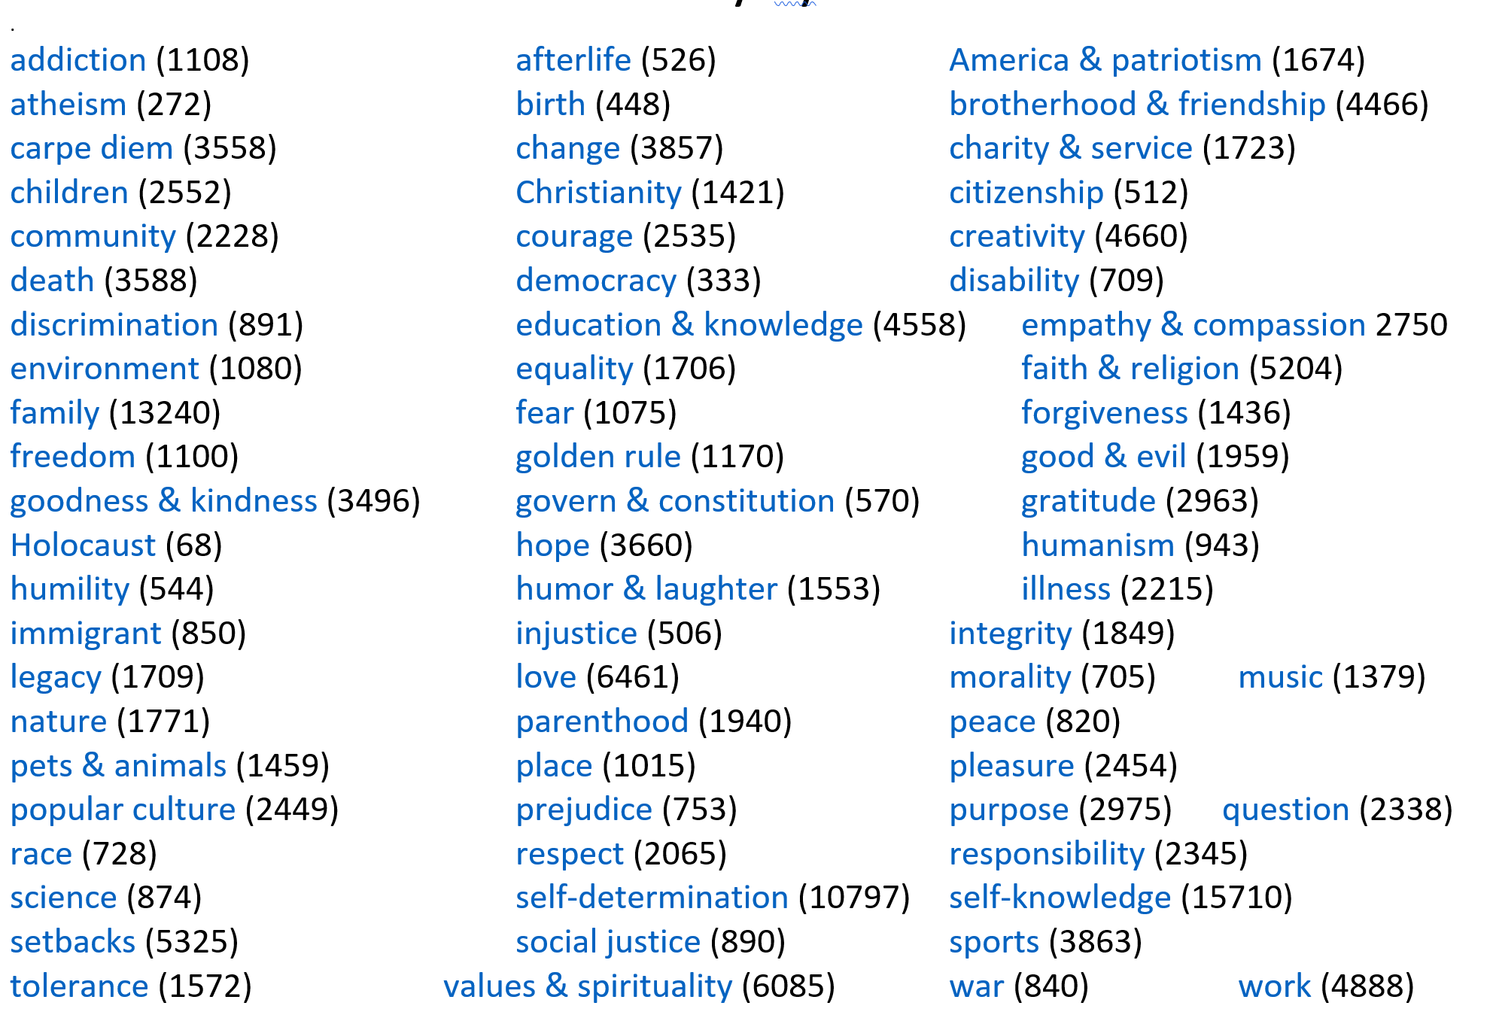

Slide 10
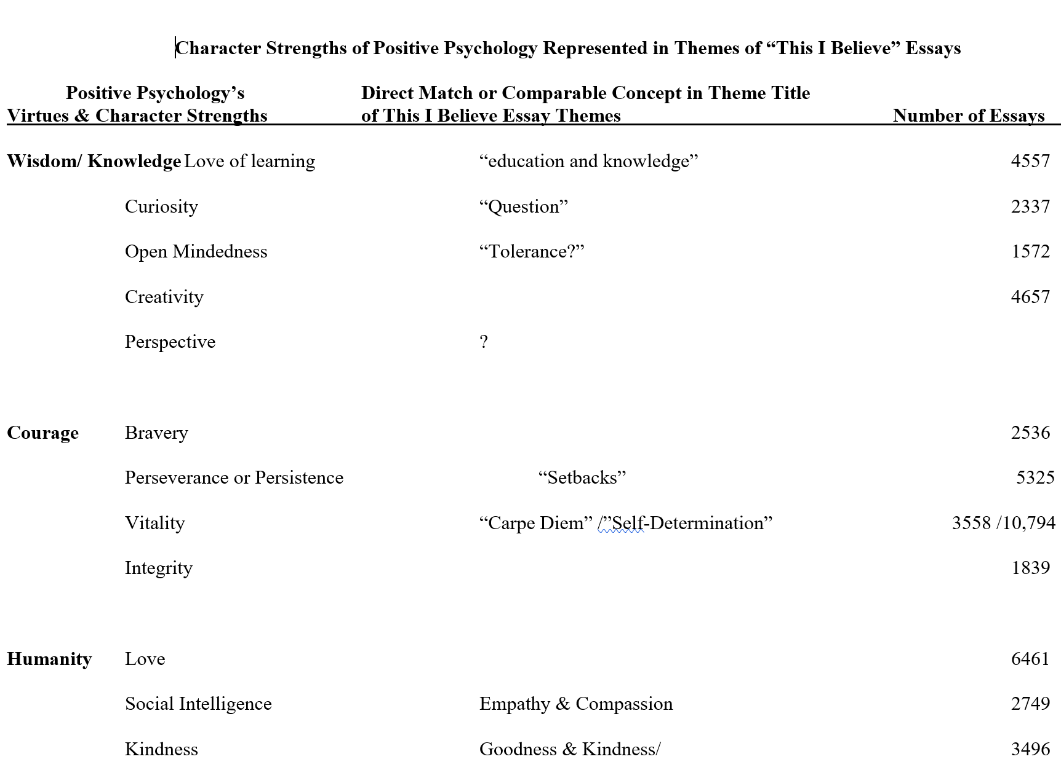

Slide 11
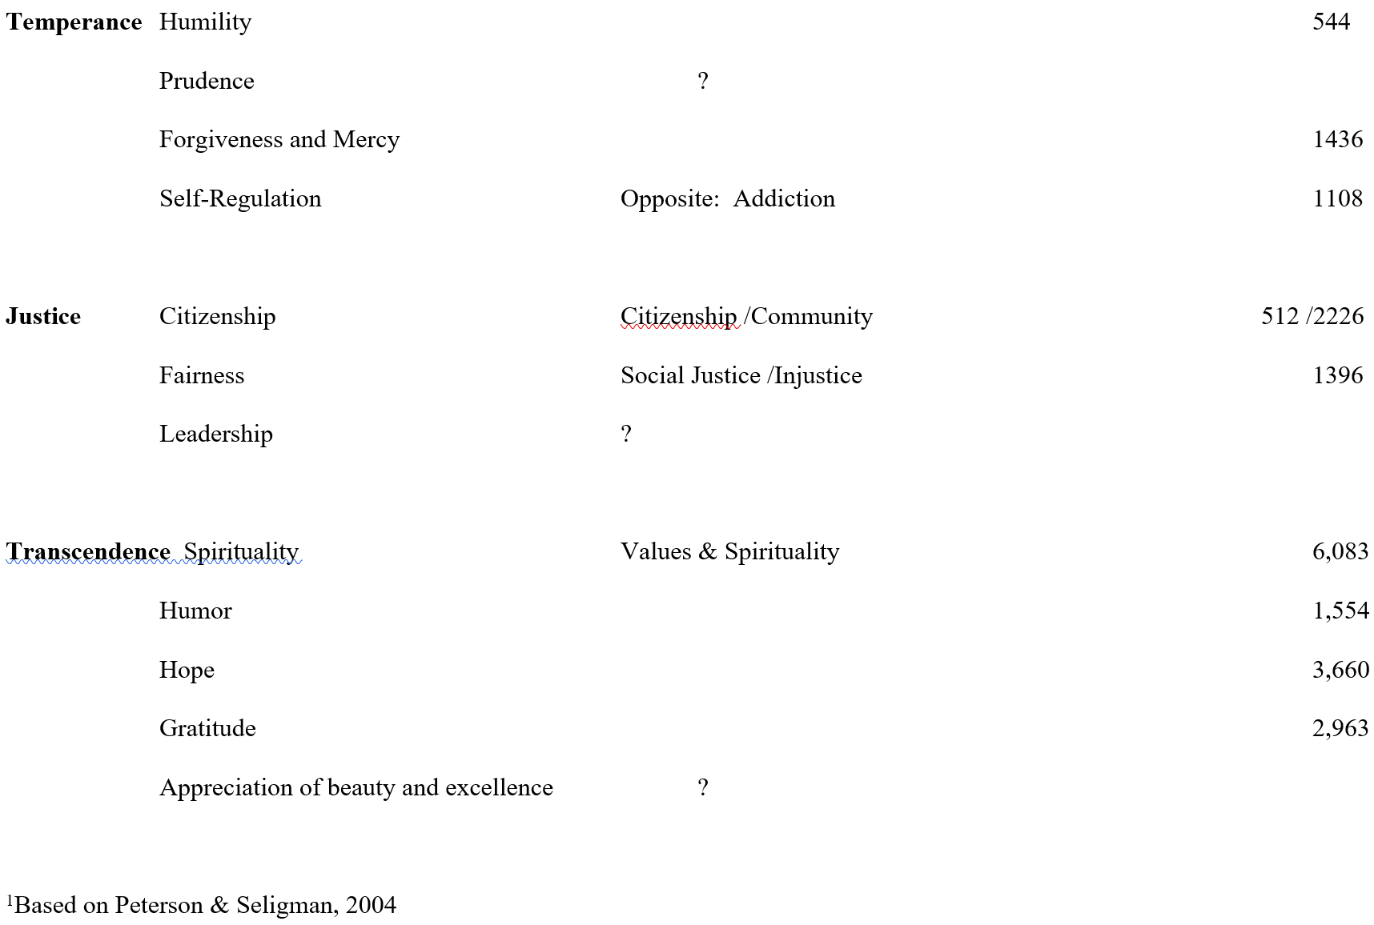

Slide 12
Instructions from Website
Tell a story about you: Be specific. Take your belief out of the ether and ground it in the events that have shaped your core values. Consider moments when belief was formed or tested or changed. Think of your own experience, work, and family, and tell of the things you know that no one else does. Your story need not be heart-warming or gut-wrenching—it can even be funny—but it should be real. Make sure your story ties to the essence of your daily life philosophy and the shaping of your beliefs.
Be brief: Your statement should be 500-600 words. That’s about three minutes when read aloud at your natural pace.
Name your belief: If you can’t name it in a sentence or two, your essay might not be about belief. Also, rather than writing a list, consider focusing on one core belief.
Be positive: Write about what you do believe, not what you don’t believe. Avoid statements of religious dogma, preaching, or editorializing.
Be personal: Make your essay about you; speak in the first person. Avoid speaking in the editorial “we.” Tell a story from your own life; this is not an opinion piece about social ideals. Write in words and phrases that are comfortable for you to speak. We recommend you read your essay aloud to yourself several times, and each time edit it and simplify it until you find the words, tone, and story that truly echo your belief and the way you speak.

Slide 13
Assessing Students’ Experience
Each student evaluated by classmates & instructor on 4 point scale
Along with some “speech” basics, I asked about:
Meaningfulness of presentation?
Learning something of value?
Can relate to presenter better than before today?
Being Inspired by presentation?
How was this inspiration experienced ?

Slide 14
Inspiration from Others vs. joy as a “control” positive emotion (From Algoe & Haidt, 2005)
Emotions→: “Elevation” Admiration Happiness or Joy
Elicitor Other exceeding Others exceeding Progress toward or Standards of Virtue Norms for Skill /talent achieving goal
Label None admiration happiness
Physical Warm, uplifting Energization Energization
Feeling in Chest
Motivation Do Good Deeds Emulate, Work harder Celebrate, tell others
Relationship Open to others Be near admired person None

Slide 15
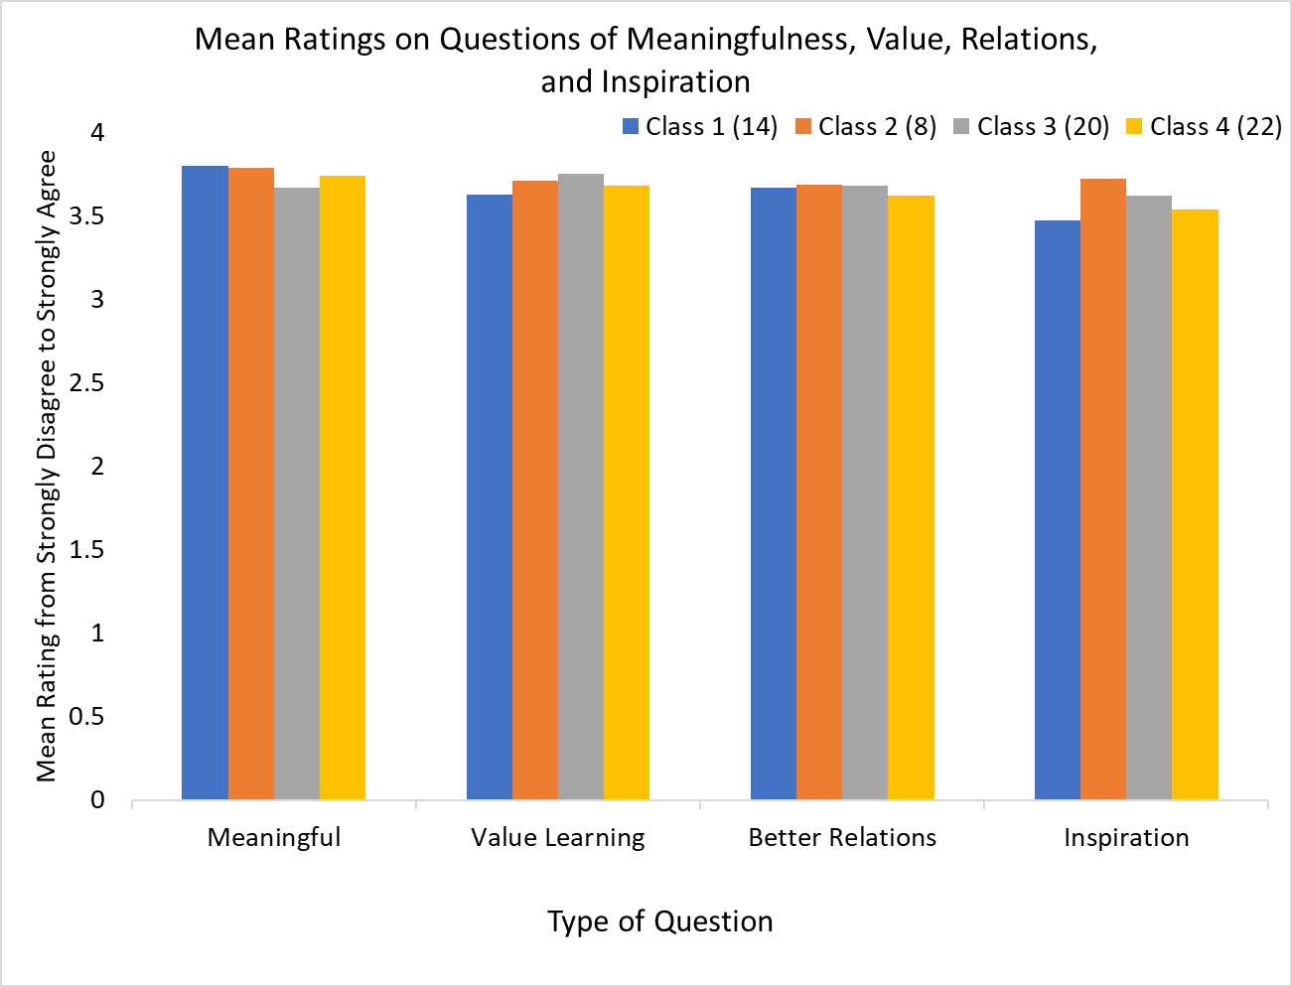

Slide 17
Benefits of Presenting “This I Believe” Essays
Immediate effects reported by students in their ratings and feedback to their peers suggests at the least a good class period or two
Courageous to make a personal presentation
Building bonds with others who have or will share their story and beliefs
Empathetic Responses to Others and Improved Class Atmosphere
Connecting better to related course material
Benefits for the those least accomplished?

Slide 18
Qualitative Aspects of Experience
Same Day or Soon After & End of Course
Years later? There’s some research for the future! (n =135 ).
Qualitative Descriptions: “Best assignment; most meaningful assignment, “converted from suspicion to awe of what happened” “I feel so connected” “…never knew their story—shouldn’t have judged” “I hope I learn to live by, and remember these values on a day to day basis”
Of Individual Essays: amazing, brave, uplifting, felt the passion, empathized with your pain; delighted by your love; so proud of your resilience, I never knew you until now, beautiful, raw, & honest; such a new insight about living well!;

Slide 19
Potential for Research
Would concepts be enlightened if one wrote an essay about the idea along with a story? Would writing a hypothetical TIB essay by an historical figure be a good assignment?
Classroom atmosphere assessments?
Could TIB essay writing and presentation serve as an “intervention”?
Role of values assertion on reducing the achievement gap. Students from lower class levels showed marked improvement when writing about their values in a teacher-blind intervention in middle schools early in semester.
Back to the idea on positive emotions from a TIB presentation—any lasting effects?

Slide 20
Why Positive Emotions are Important
Barbara Fredrickson’s work on “broaden and build” shows that the experience of positive emotions open us to new ideas and provide the motivation to build skills.
Working together with humor, cooperation, respect, etc. tends to improve productivity and overcome any angst about the work

Slide 21
Your Turn! Look up the site or examine handout list, and explore with a neighbor
https://thisibelieve.org/
https://www.npr.org/series/4538138/this-i-believe
https://www.mightycause.com/organization/This-I-Believe-1
EMAIL: admin@thisibelieve.org This I Believe, Inc. P.O. Box 5625 Phone: (502) 259-9889 Louisville, KY 40255

Slide 22
adamsn@wssu.edu
Questions?

