Slide 1
Dynamic Classroom Dialogue: Can Students be Engaged Beyond Discussion?
Lily Conference (January 2020)
Roxanne Long, Ph.D.
University of North Texas

Slide 2
SMALL GROUP METHOD
Four decades of research show positive effects
Theoretical framework
(cognitive elaboration, cognitive conflict, expert to non-expert, co-construction)
Prepare Students
Status Relationships
Assign Groups
Structured Controversy
Webb, N.M. (2009). The teacher’s role in promoting collaborative dialogue in the classroom. British Journal of Educational Psychology, 79, 1-28.

Slide 3
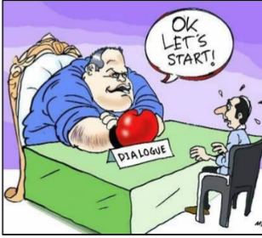
Dialogue versus Discussion
Dialogue listens with empathy
Dialogue participants must be “equals”
Dialogue uncovers starting assumptions
Yankelovich, D. (1999) The Magic of Dialogue. New York, NY: . Simon & Schuster, Inc
Adapted from Brenda McCoy, PhD

Slide 4
Classroom Dialogue: A Systematic Review
40 years of empirical research
Single classroom, content controlled, all modalities, recordings, IRF, dialogic interaction
TAKE AWAYS:
Crucial for Effective Pedagogy
Dialogue makes exchange of competing ideas possible
Small group student-student richness of student contribution
Non-evaluative feedback
Bakhtin, M. (1981). The dialogic imagination: Four essays. Austin: University of Texas Press.
Howe, C. & Abedin, M. (2013). Classroom dialogue: a systematic review across four decades of research. Cambridge Journal of Education, 43, 325-356.

Slide 5
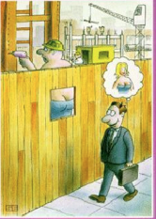
Starting Assumptions
Treat all assumptions with respect
Examine personal assumptions and identify those of others
Yankelovich, D. (1999) The Magic of Dialogue. New York, NY: . Simon & Schuster, Inc
Adapted from Brenda McCoy, PhD

Slide 6
Dialogue versus Debate
Dialogue does not tune out views that are in disagreement
Dialogue does not marshal arguments to rebut
Dialogue does not seek reinforcement to own prejudices

Slide 7
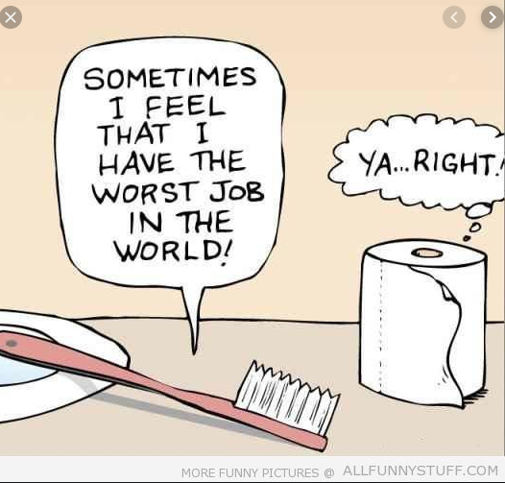
Definition of Dialogue
A process of seeking mutual understanding
Internalize the views of the other
Strengthen relationships and solve problems
Yankelovich, D. (1999) The Magic of Dialogue. New York, NY: . Simon & Schuster, Inc
Adapted from Brenda McCoy, PhD

Slide 8
We Need Dialogue
Eroding social bonds
Rise of impersonal transactions
Increasing diversity
Less unquestioned authority in the workplace and other institutions
Yankelovich, D. (1999) The Magic of Dialogue. New York, NY: . Simon & Schuster, Inc
Adapted from Brenda McCoy, PhD

Slide 9
Social versus Individual Demonstration
Let’s Try It : )

Slide 10
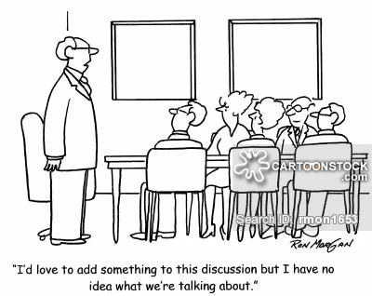
CLASS DIALOGUE GROUND RULES
1) Civil at all times
2) Dialogue not debate
3) Everyone is right mentality
4) Welcoming of alternate perspectives for the sake of learning
5) NO NAMES
6) NO eye rolls, sarcasm, noises, etc.
7) Breaks okay
8) Confidence to participate
9) CELL PHONE policy
10) Google’s Perfect Team

Slide 11
Steps to Effective Dialogue
Listen with Empathy
Accept others without Judgement
Ask Questions
Respond
Yankelovich, D. (1999) The Magic of Dialogue. New York, NY: . Simon & Schuster, Inc
Adapted from Brenda McCoy, PhD

Slide 12
References
Bakhtin, M. (1981). The dialogic imagination: Four essays. Austin: University of Texas Press.
Duhigg, C. (2016, Feb. 25). What Google Learned from its Quest to Build the Perfect Team. The New York Times Work Issue.
Elkind, D.H. & Sweet, F. (1997). The Socratic Approach to Character Education. Educational Leadership, 54, 56-59.
Howe, C. & Abedin, M. (2013). Classroom dialogue: a systematic review across four decades of research. Cambridge Journal of Education, 43, 325-356.
Liberali, F. (2017). Commentary: Analyzing classroom dialogue to create changes in school. Learning and Instruction, 48, 66-69.
Van der Veen, C. & Van Oers, B. (2017). Advance in research on classroom dialogue: learning outcomes and assessments. Learning and Instruction, 48, 1-4.
Webb, N.M. (2009). The teacher’s role in promoting collaborative dialogue in the classroom. British Journal of Educational Psychology, 79, 1-28.
Yankelovich, D. (1999) The Magic of Dialogue. New York, NY: . Simon & Schuster, Inc

